Slide 1


CHRISTMAS
SPECIAL DAYS

Slide 2

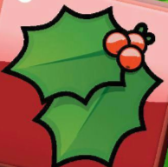
Work in pairs. Translate the following words into Croatian.
stocking
Father Christmas or Santa Claus
sweets
Christmas present
Christmas pudding
gingerbread man
cookie
holly
snowman
Christmas bauble
robin

Slide 3
Check.
stocking – čarapa
Father Christmas or Santa Claus – Djed Božićnjak ili Djed Mraz
sweets – slatkiši
Christmas present – božićni poklon
Christmas pudding – tradicionalni engleski božićni desert
gingerbread man – čovječuljak od paprenjaka/medenjaka
cookie – kolačić
holly – božikovina
snowman – snjegović
Christmas bauble – božićna kugla
robin – crvendać

Slide 4
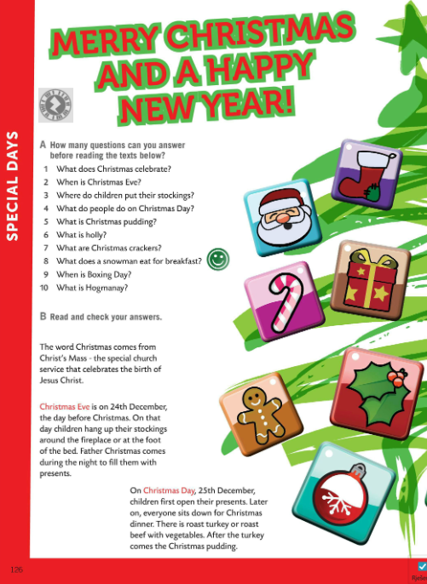
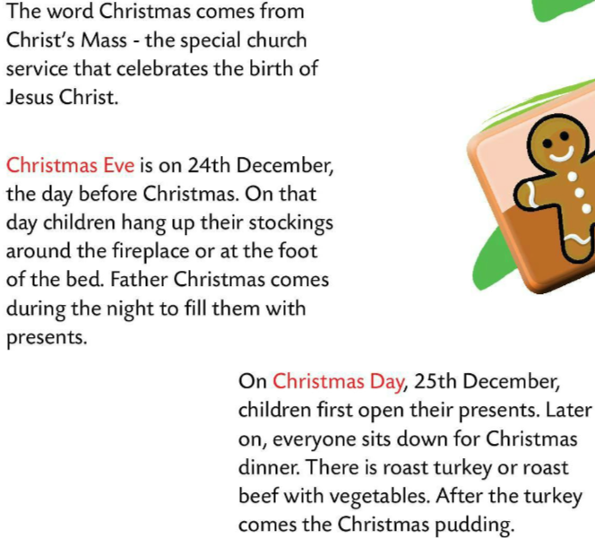
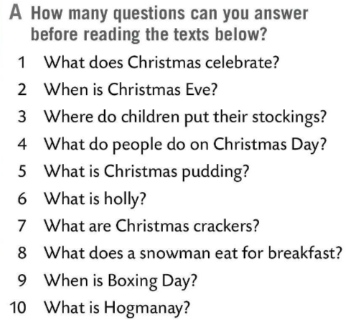
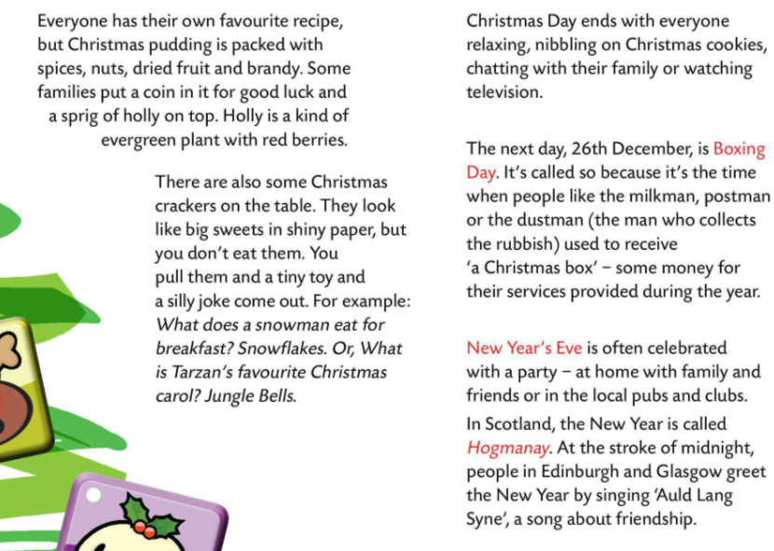
How many questions from Task A can you answer before reading the texts below?
Read the text and check your answers.

Slide 5
Let’s check the answers in Task A.
Christmas celebrates the birth of Jesus Christ.
Christmas Eve is on 24th December.
Children hang up their stockings around the fireplace or at the foot of the bed.
On Christmas day children first open their presents. Later on, everyone sits down for Christmas dinner.
Christmas pudding is a dark, sticky, and dense fruitcake made of mixed dried fruit, candied fruit peel, apples and citrus zest.
Holly is a kind of evergreen plant with red berries.
They look like big sweets in shiny paper, but you don’t eat them. You pull them and a tiny toy and a silly joke come out.
Snowman eats snowflakes for breakfast.
Boxing day is on 26th December.
In Scotland, the New Year is called Hogmanay.

Slide 6
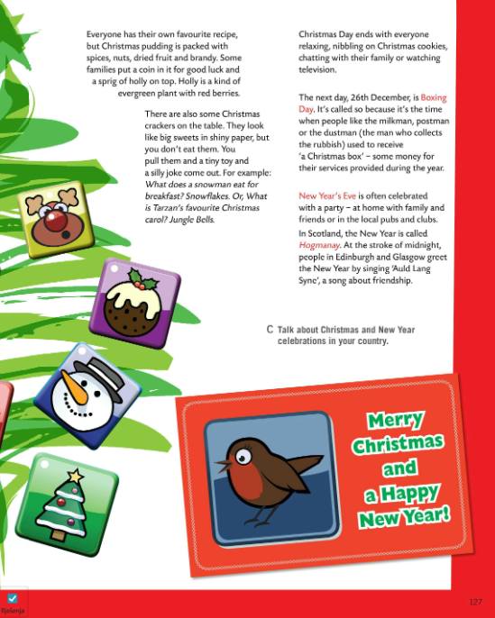

What do you think of British Christmas tradition and customs?
Which of the mentioned applies to your Christmas and New Year celebration?
Talk about Christmas and New Year celebrations in your country?

Slide 7

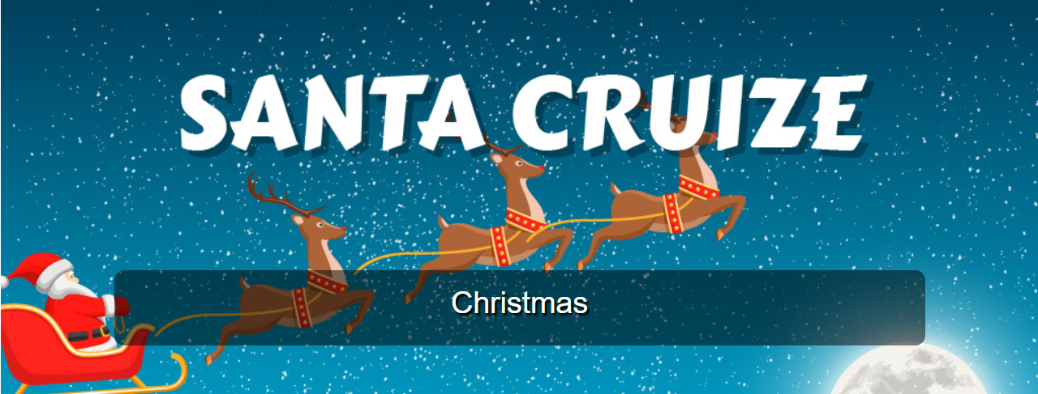
Let’s play some jolly Christmas games and revise!
https://oodlu.org/share-game/75ccc8fd-d8ba-42f6-9366-84ee78c775df?fbclid=IwAR0numcdQucPANu9nqo3ABwoUpo4quj3CihxkU5e-KPYYYWFQycr97qikpM
https://wordwall.net/play/8658/529/233

Slide 8
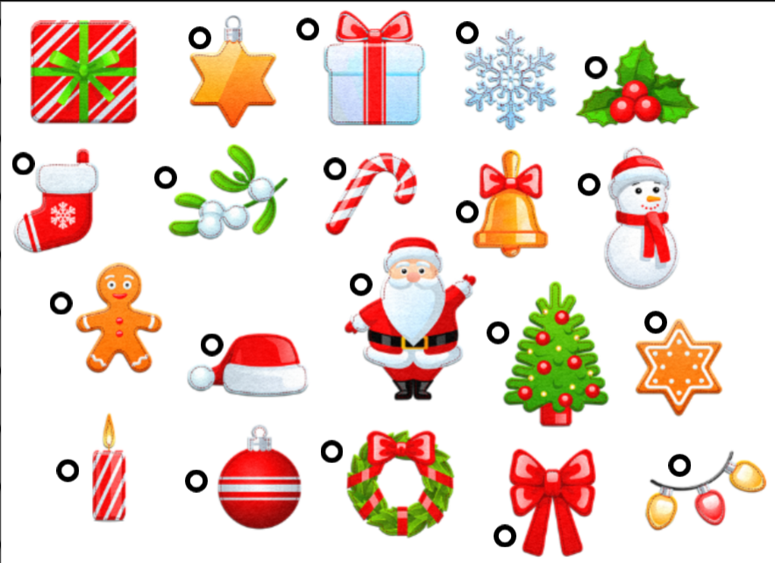
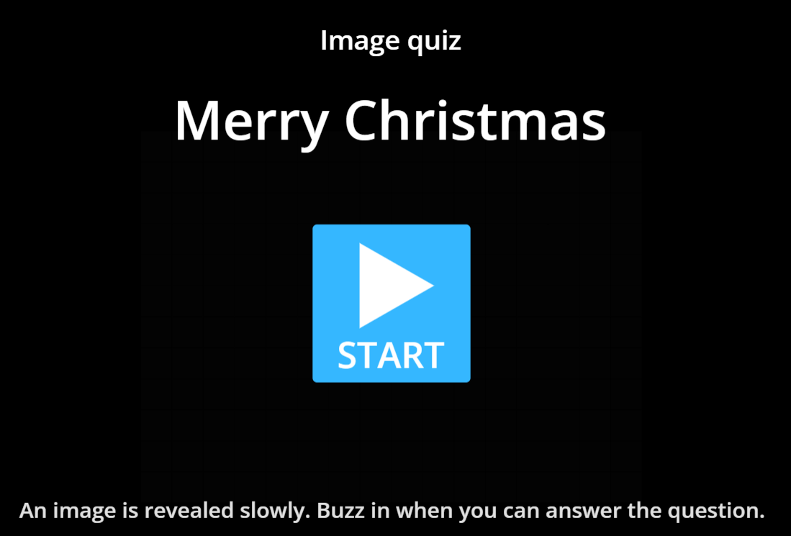
Let’s play some jolly Christmas games and revise!
https://wordwall.net/play/727/187/876
https://wordwall.net/play/354/464/108

Slide 9

Try to solve some of these Christmas riddles.
Although it might look like I belong on your toes, I’m actually hung up for gifts as every child knows. What am I?
Christmas stocking
It has a body with crispy arms, white eyes, and funny feet. You might love to eat this too. What is it?
Gingerbread man.
These are what Santa likes to eat. At every house he stops, he’s looking for this treat. What are these?
Milk and cookies.
My job often leaves me frozen; I am a man that all should know, but I only come out during times of sleet or ice or snow. Who am I?
A snowman.
Not there yesterday, and also not there tomorrow night. Opened up on the eve, sharing hope and love on yuletide. What is it?
A present.

